Slide 1
Welcome to Hello World Series
Version control with DBMS and it's problems

Slide 2
In last tutorial...
We agreed that some sort of Version Control System (VCS) is required.

Slide 3
In this tutorial...
We will try to manage file changes in database.

Slide 4
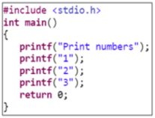



Individual revisions on local database
There are 3 developers – A, B & C.
Each one of them is working on a C Hello World program, which prints numbers

Slide 5
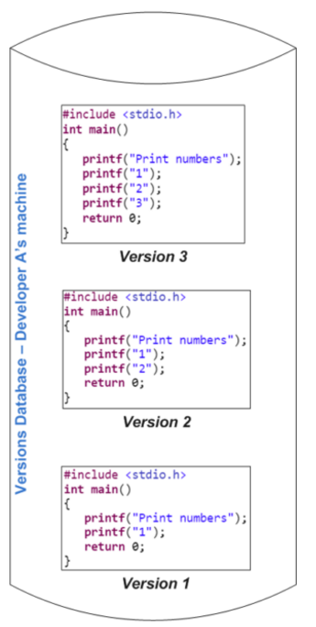
Individual revisions on local database

Slide 6
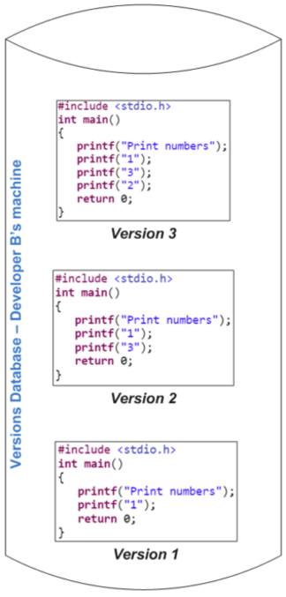
Individual revisions on local database

Slide 7
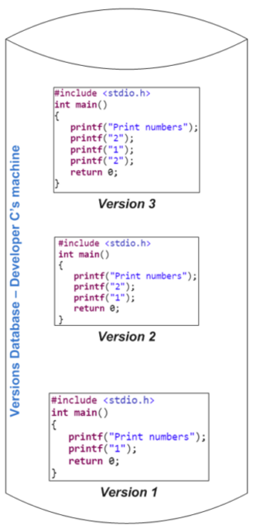
Individual revisions on local database

Slide 8
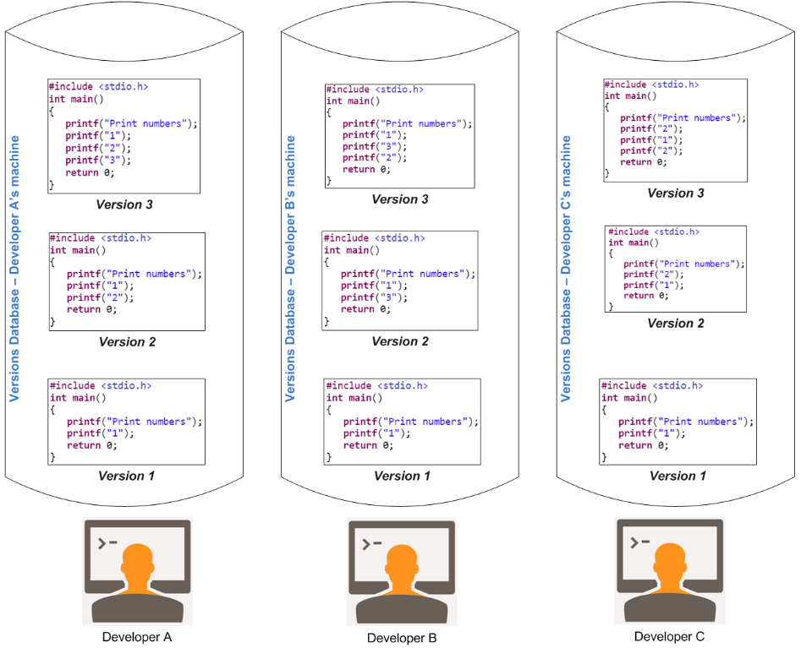
Issue in this approach
No collaboration
among developers

Slide 9
Another approach could be – shared database
But that is also not useful for merging, tracking history, branching etc.

Slide 10
What to do then….
Watch next tutorial for the answer…

Slide 11
Coming up Next
Introduction to Centralized Version Control
Notes:
In Slide Show mode, click the arrow to enter the PowerPoint Getting Started Center.

